Slide 1
Using Active Learning to Decrease Probes for QoT Estimation in Optical Networks

Slide 2
Main contributions of the article
Applying regression technique capable of learning with few parameters
Improvement of regression techniques (unspecified) when forecasting QoT
Combination of Active Learning with Gaussian Processes
Estimation in a field on which there is noise during measurements (assuming Gaussian noise)

Slide 3
Model
Input: modulation format, traffic volume, lightpath length, number of links traversed by the lightpath and length of the longest traversed link
Output: BER (Bit Error Rate)
Assumption that observed BER measurements are not deterministic wrt features. The noise is approximated with a Gaussian noise. GP helps in this
Model: Active Learning (AL) technique to improve an initial model trained on a small dataset. Kernel method using Gaussian process (identified by a covariance parameter and a mean) for inferencing (but no details on how the ML predictor works)
First step: train with a (small) dataset the ML predictor, that estimates the covariance parameter. Posterior mean and covariance are inferenced
Second step: apply AL iteratively to learn from additional instances from near-to-threshold BER values (the GP is the one that evaluates the distance from the threshold G, that is an hyper-parameter). So, a selection of the instances is done, by considering those that provide more information

Slide 4
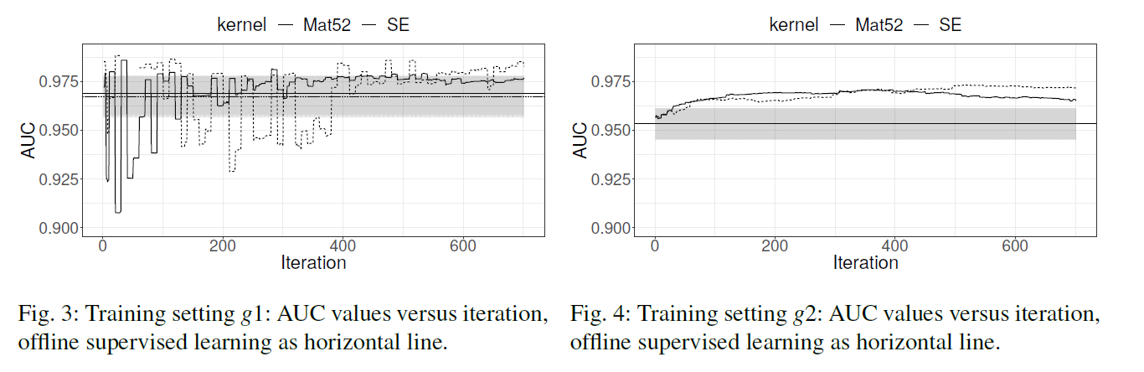
Simulation and results
2 datasets generated with Qtool (g1 or g2, depending on a setting. Some technical characteristics are defined). Test set consists of 2k instances, 200 for initial training and then 700 AL iterations
Comparison with a 900 offline supervised learning technique, 200 randomly from g1 or 2 and 700 uniformely from g2
Two kernel functions considered
Improvement in both the settings

Slide 5
Strengths and falls
Strenghts
Falls
Ability to learn from a small dataset
Comparison with an undefined supervised learning technique, that will provide for sure low performances with low amount of data if the model is complex
Application of kernel techniques
Kernel techniques usually are slow in inferencing, and not suitable for online inferencing as estimation of QoS combined to SDN may require
Great learning despite the low amount of data
No trial on estimation of QoS problem

